Slide 1
Sales Forecasting Across Multiple Retail Stores
Project 6
Submitted TO - NextHikes IT Solutions
Submitted By- RAJBIR KAUR

Slide 2
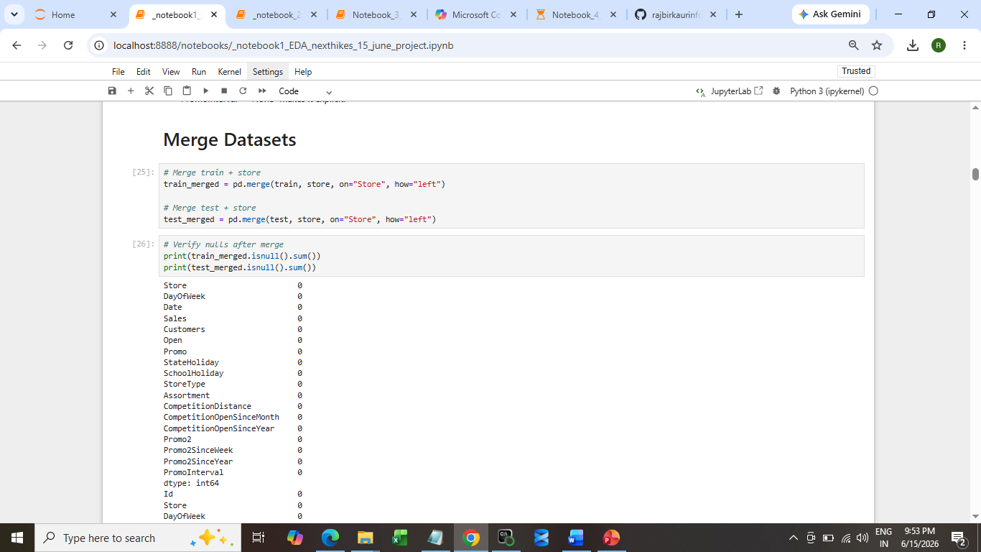
1ST Notebook for detailed EDA Process

Slide 3
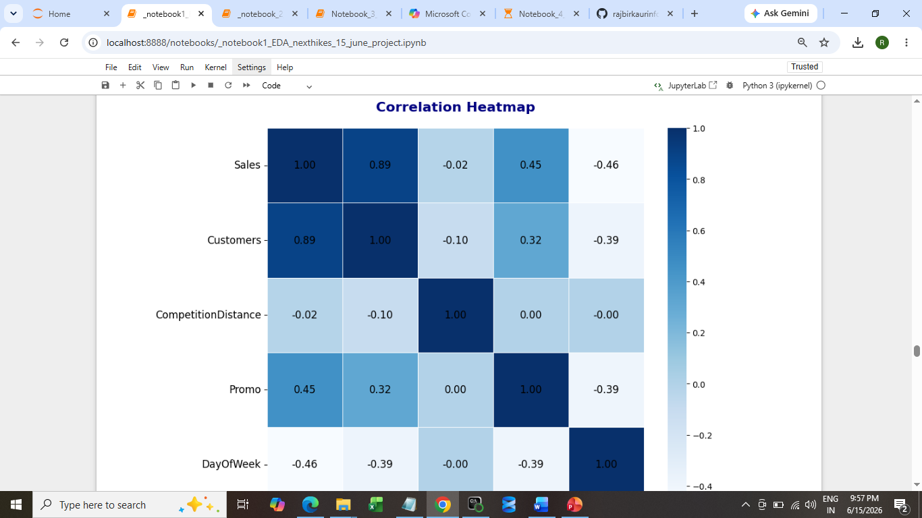
Univariate analysis, Bivariate analysis, Multivariate analysis

Slide 4
Business Insights-
Promos + assortment synergy drives sales growth.
Customers are the strongest predictor, but categorical factors (holidays, promos, assortment, competitor presence) explain variability.
Holiday closures are structural dips — promos soften but cannot erase them.
Competitor openings reduce sales, especially in dense city centers.
Strategic deployment of promos in high‑traffic, extended assortment stores yields the best ROI.

Slide 5
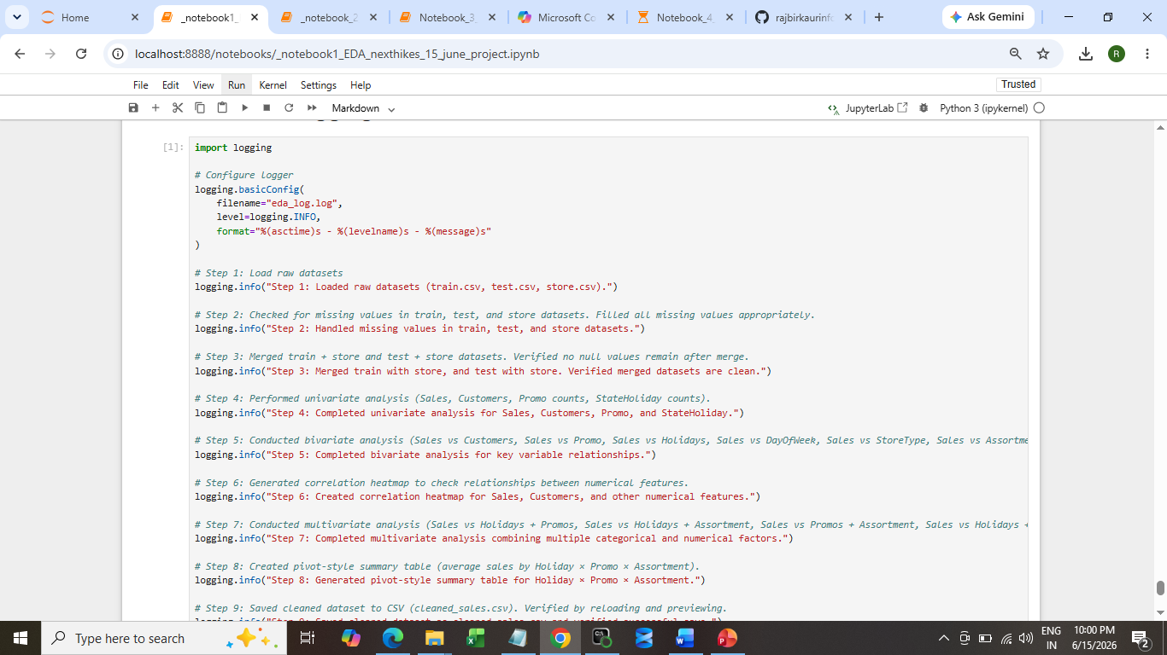
Logging

Slide 6
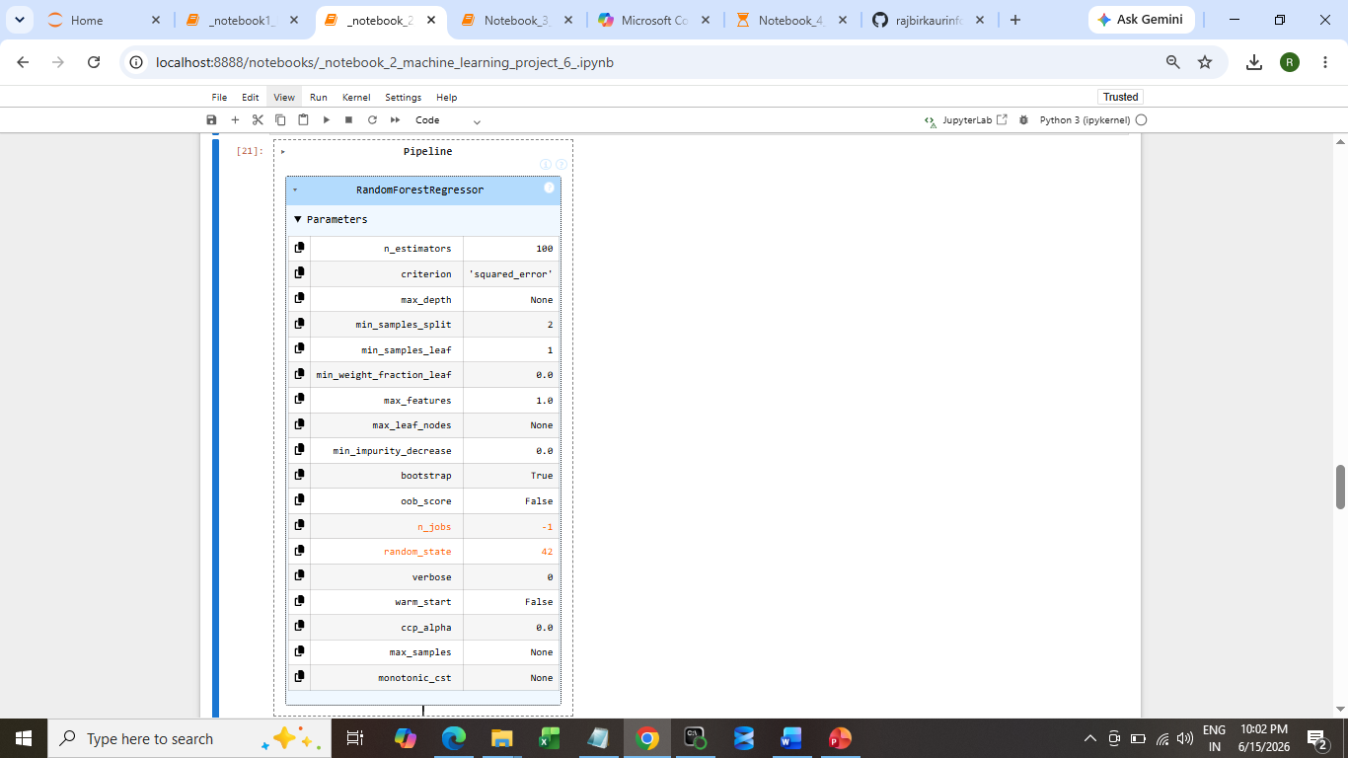
Notebook 2 - Machine Learning, Build Pipeline with Random Forest

Slide 7
Why This Is Good
RMSE ≈ 719 => means your average prediction error is about 719 sales units. Given the dataset scale (sales often in thousands), that’s a very tight error margin.
R2 ≈ 0.965 => means the model explains ~96.5% of the variance in sales. That’s a very strong fit, showing the features you engineered (date, promos, holidays, etc.) are highly predictive.
Selected Loss Function: RMSE
Post‑prediction analysis was conducted to interpret model behavior and assess reliability. Feature importance analysis revealed that promotional activity and competition distance were the strongest drivers of sales, while holiday and temporal effects played secondary roles. To estimate confidence intervals, we leveraged the variability of predictions across individual trees in the Random Forest.

Slide 8
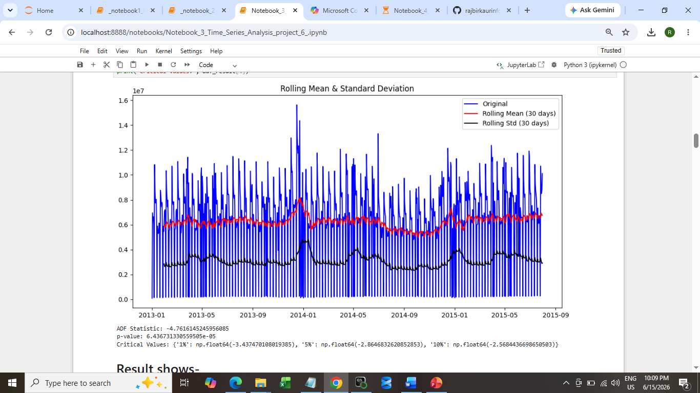
Notebook 3 - Time Series Analysis

Slide 9
The sliding‑window transformation successfully reframed the Rossmann sales time series into a supervised learning dataset.
The Rossmann sales time series has been successfully reframed into a supervised learning dataset. Each 30‑day block of past sales is used to predict the following day’s sales, enabling accurate forecasting of daily demand for business planning.
The dataset has been normalized into a 0–1 range, ensuring all features contribute equally during training. This scaling improves model stability, accelerates convergence, and enhances forecasting accuracy for both ARIMA and LSTM approaches.

Slide 10
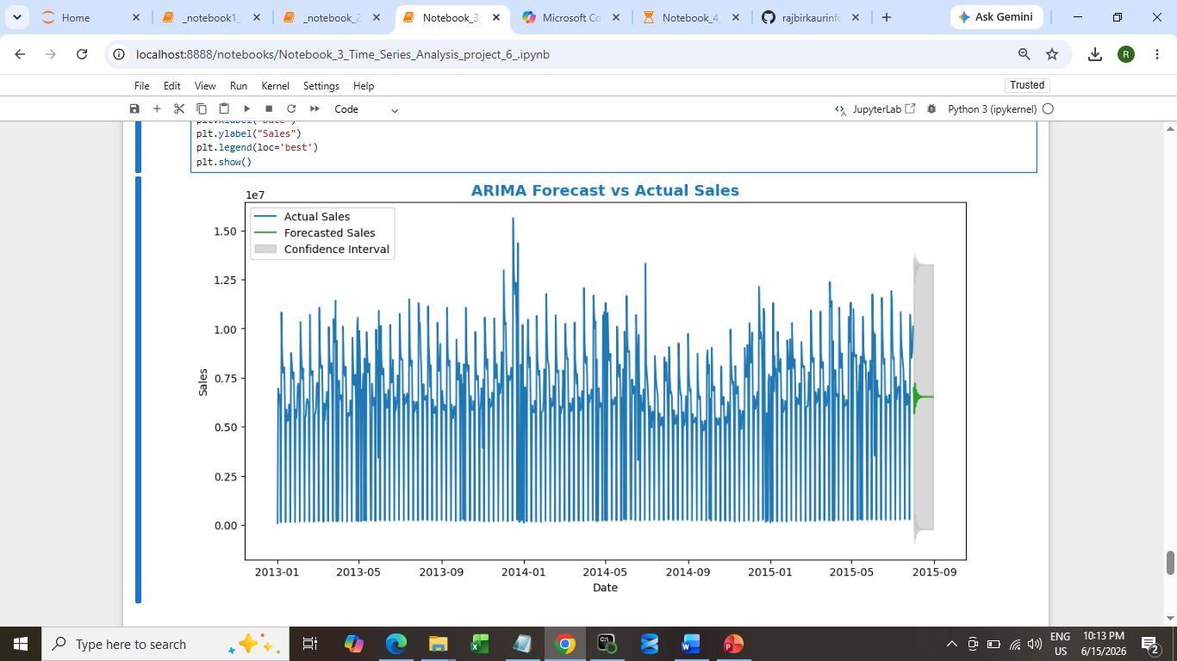
Forecast vs actual sales

Slide 11
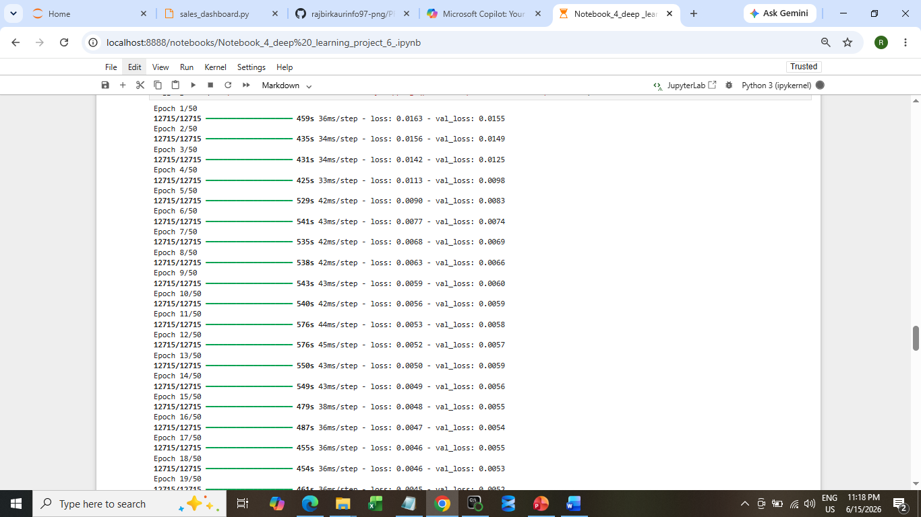
Notebook 4 = Deep learning (LSTM/RNN)

Slide 12
Prediction + Inverse Scaling
Predicted Sales: 6787.8706 Actual Sales: 7248.000000000001
Predicted Sales: 5817.2036 Actual Sales: 6395.0
Predicted Sales: 9438.293 Actual Sales: 10788.999999999998
Predicted Sales: 9675.085 Actual Sales: 11144.0
Predicted Sales: 12273.988 Actual Sales: 12412.0
RMSE: 1335.17
MAE: 831.39
R²: 0.880

Slide 13
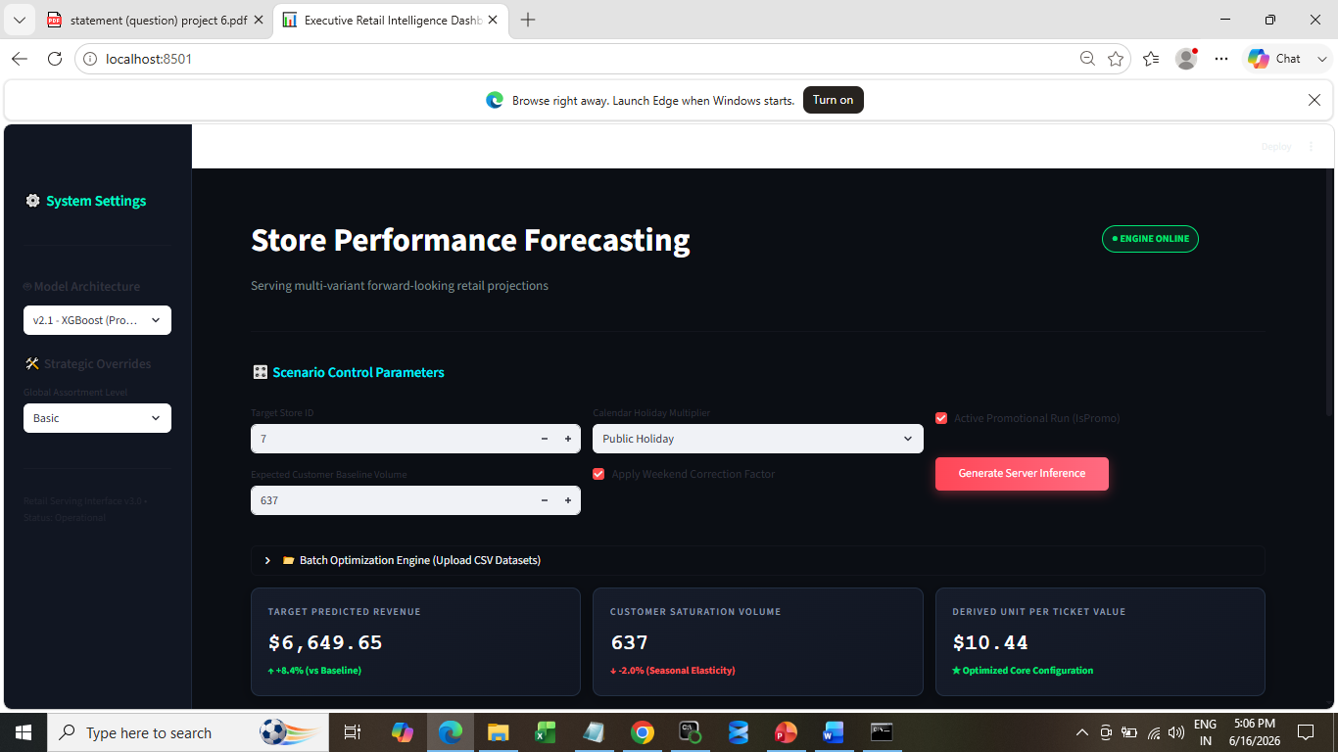
streamlit run sales_dashboard.py

Slide 14
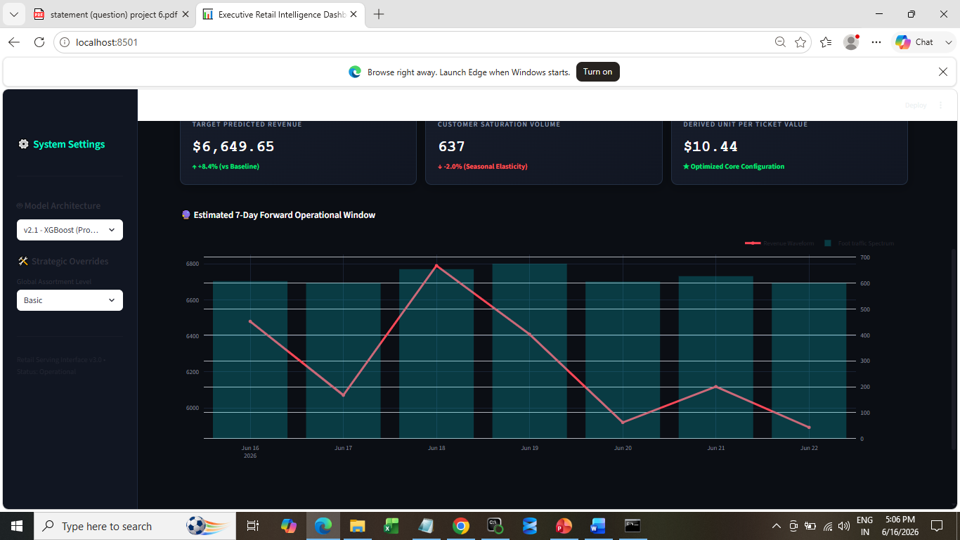
Local URL: http://localhost:8501 Network URL: http://192.168.31.18:8501

Slide 15
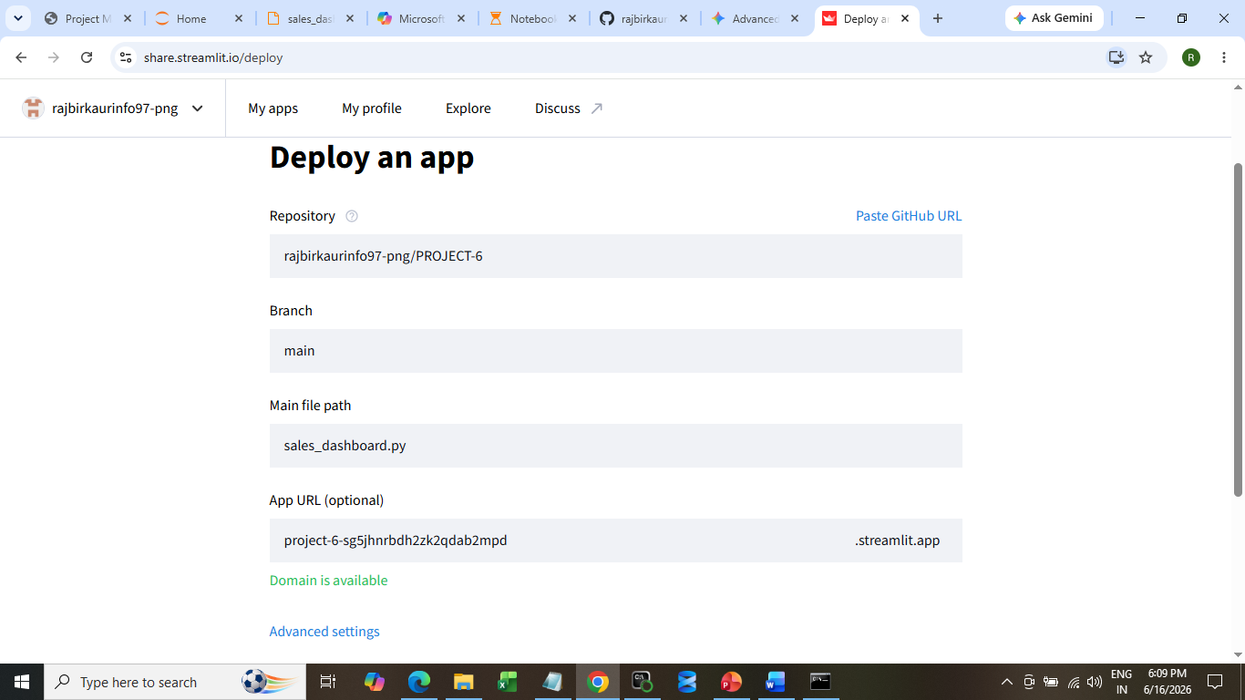
URL domain - project-6-sg5jhnrbdh2zk2qdab2mpd

Slide 16
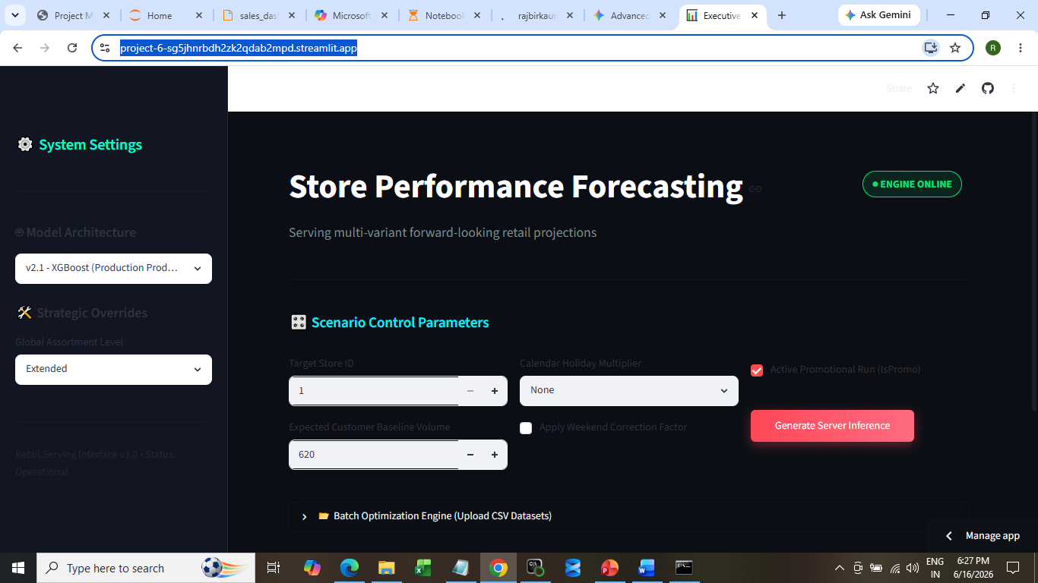
The Live Site Link
https://project-6-sg5jhnrbdh2zk2qdab2mpd.streamlit.app/

Slide 17
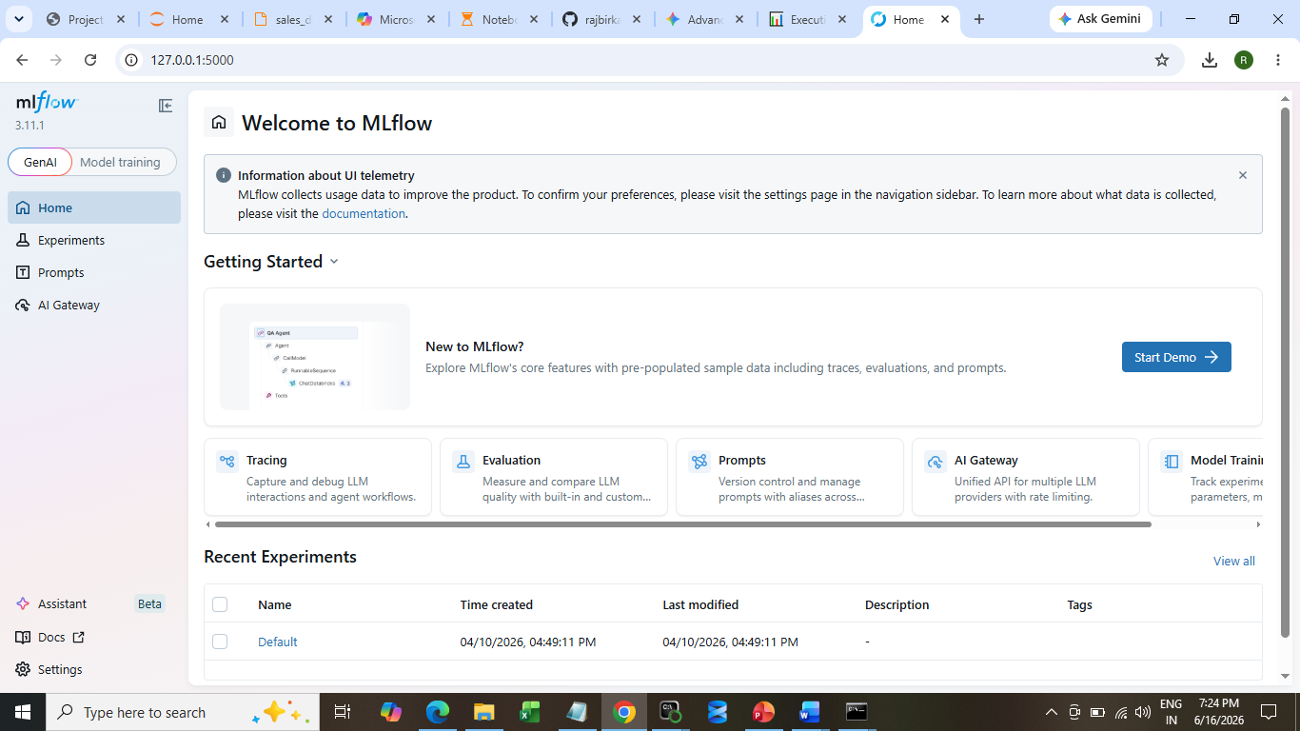
Mlflow dashboard

Slide 18
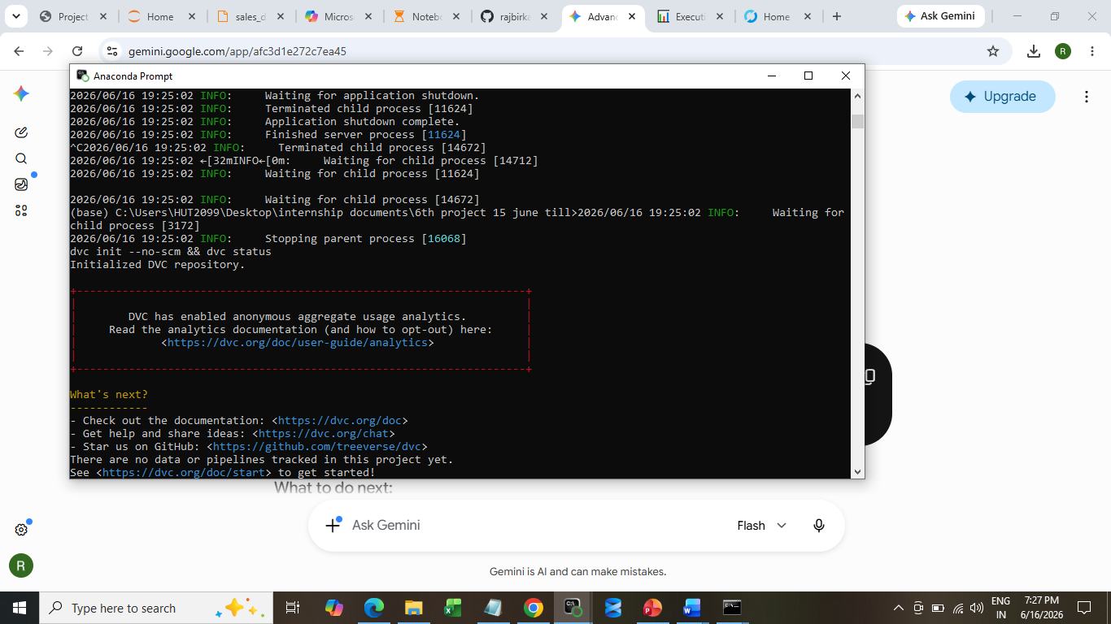
DVC tracks

Slide 19
References
MLflow Tracking Documentation (mlflow.org)
Streamlit Framework (streamlit.io)
Scikit‑Learn Machine Learning Library (scikit-learn.org)
Google
You tube

Slide 20


